Slide 1
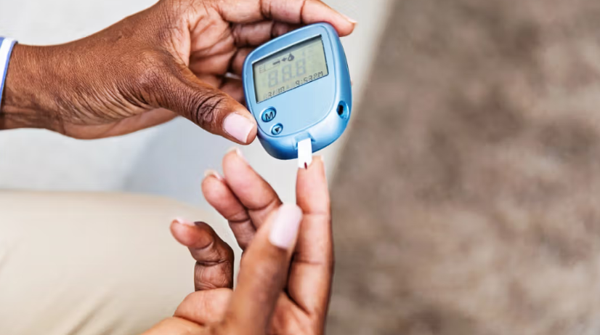



«Understanding Diabetes Progression»
Dimitrios Pouliakis
Data Analytics and Statistics Seminar
unLocking carEer potentiAl with comPlex systems, statistics, data analytics and machine learning
(LEAP)
https://www.bcbsm.mibluedaily.com/stories/prevention/how-to-choose-a-glucose-monitor

Slide 2
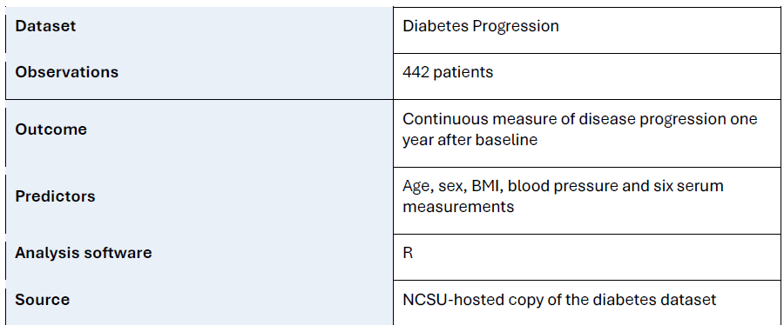
Dataset
Small Dataset
Can’t generalize to other population
But we can link some variables to diabetes progression, that could be established also from theories
2

Slide 3
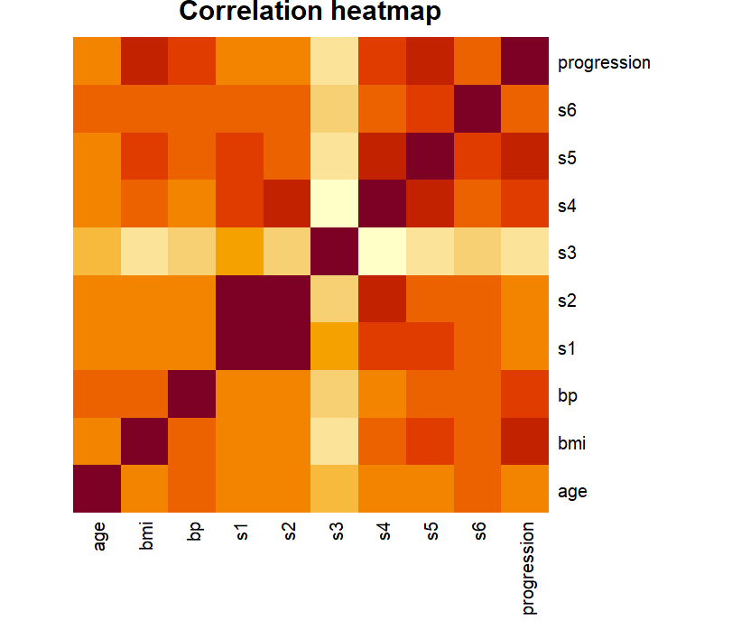
Preliminary Feature Selection
We found an early association of the BMI, S5 measurement and BP as also other variables, but wasn’t so obvious to test them to our first models
Darker orange, stronger association
?
3

Slide 4
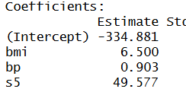

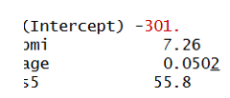
Results
1st Model (Only BMI):
For every 1 increasing unit in BMI, 10.233 increase diabetes progression score
2nd Model (BMI + BP + S5):
For every 1 increasing unit in BMI, 6.5 increase diabetes progression score
For every 1 unit in BP, only 0.9 increase in the score (low effect proved)
For every 1 unit in S5, 49.577! Proved S5 Strong Effect
3rd Model (BMI + BP + S5):
Approximately same results, bp really didn’t have strong effect!
4th Model (BMI + Age+ S5):
Age, also very weak effect, despite our intuitions
4

Slide 5
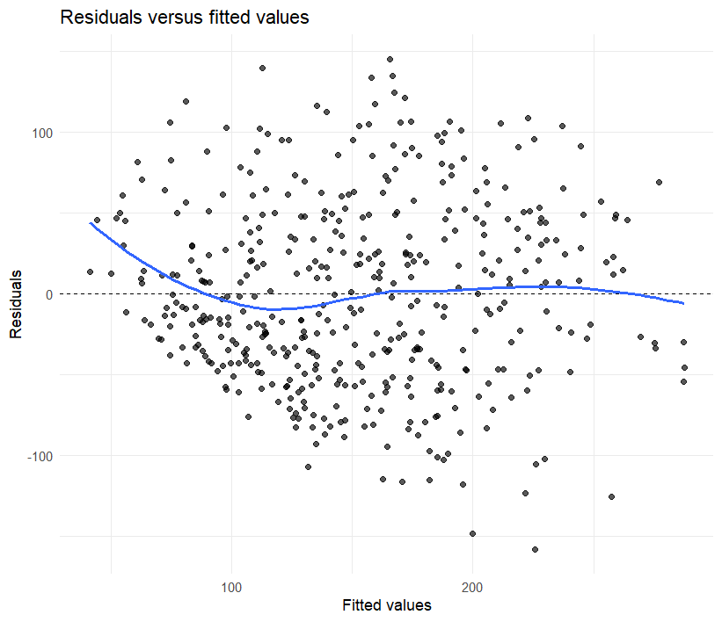
Conclusions
BMI and S5 Measurements seem to be associated with the progressions of the Diabetes
BP and Age! Don’t have strong effect, despite our intuitions that older people are more prone to diabetes
BUT small dataset and also age could be linked through different measurements indirectly to the progression
This cluster could be further studies for non-linear effects, as the residuals in many cases of real values and the model are far away from the optimal zero, or a constant behaviour
5

Slide 6
Data Source:
https://www4.stat.ncsu.edu/~boos/var.select/diabetes.tab.txt
6

Slide 7
Thank you!
Any Questions?

